Slide 1
Exceptional Exceptions
LET’S PLAY CATCH

Slide 2
What are Exceptions?
An event that disrupts the normal flow of a program
Different from an error
Exceptions should be handled by the application
User has entered invalid data
Application cannot find specified file
Communications with another device is cut off

Slide 3
Categories of Throwables
Checked Exceptions
Found during compile time
Unchecked
Found during run time
Error
Not an exception, but neither user nor programmer is expected to handle them

Slide 4


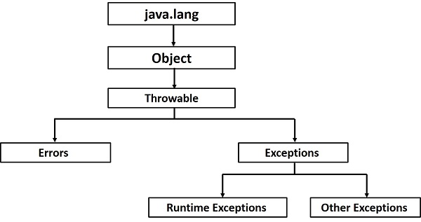



Exception Hierarchy

Slide 5
Example code that needs Exception handling
public class FileNotFound {
public static void main(String args[]) {
FileWriter myWriter = new FileWriter("C://filenotfound.txt");
myWriter.write("Hi, I'm trying to write something.");
myWriter.close();
}
}

Slide 6
Catching Exceptions
//Try and catch block
public class Maps {
public static void main(String[] args) {
try {
HashMap<String, String> map = new HashMap<String, String>(null);
map.put(null, null);
map.remove(null);
}catch (NullPointerException e){
System.out.println(e);
}
}
}

Slide 7
Multiple Catch Blocks
public class HandlingChecked {
public static void main(String args[]) {
FileWriter myWriter;
try {
myWriter = new FileWriter("C://filenotfound.txt");
myWriter.write("Hi, I'm trying to write
something.");
myWriter.close();
} catch (IOException e) {
System.out.println("Exception thrown: " + e);
} catch (Exception e){
System.out.println("Exception thrown: " + e);
} finally {
System.out.println("End of execution.");
}

Slide 8
Multiple Exceptions
You can have a block handle multiple exceptions
Try{
riskyMethod();
}
Catch(exception1|exception2){
handleException1();
handleException2();
}

Slide 9
Checked Exceptions
public class MoreChecked {
public static void main(String[] args) {
method1();
}
public static void method1() throws FileNotFoundException, ClassNotFoundException {
// Throws FileNotFoundException if the file doesn't exist
FileInputStream fis = new FileInputStream("C2:\\badFileName.txt");
}
}

Slide 10
Throws and Throw Keywords
Throws allows a method to “duck” exception handling
public static void method1() throws FileNotFoundException, ClassNotFoundException {
FileInputStream fis = new FileInputStream("C2:\\badFileName.txt");
}
Throw allows a method to manually throw an exception object
Public void method2() throws CustomException{
throw new CustomException();
}

Slide 11
The Finally Block
public class HandlingChecked {
public static void main(String args[]) {
FileWriter myWriter;
try {
myWriter = new FileWriter("C://filenotfound.txt");
myWriter.write("Hi, I'm trying to write
something.");
myWriter.close();
} catch (IOException e) {
System.out.println("Exception thrown: " + e);
} catch (Exception e){
System.out.println("Exception thrown: " + e);
} finally {
System.out.println("End of execution.");
}

Slide 12
Try-with-Resources
Java 7 has automatic resource management, which automatically closes any resources opened in a try block
try(FileWriter myWriter = new FileWriter("C://filenotfound.txt")){
myWriter.write("Hi, I'm trying to write something.");
myWriter.close();
} catch (IOException e) {
System.out.println("Exception thrown: " + e);
}

Slide 13
Create your own Exceptions
Child of throwable
If you want to make a checked exception, need to extend exception class
If you want to make a runtime exception, need to extend runtimeException class

